Slide 1
Project Proposal of SwasthyaAI
Presented By
Bikram Chapagain
Deepa Paneru

Slide 2
Contents
Introduction
Why SwasthyaAI
Objectives
Scope and Limitations
Model Pipeline
System Requirements
Disease Modules
Data cleaning and Spilitting
Model Training
Evaluation Strategy
Architecture,Usecase Diagram ,Dataflow Diagram,
Cost Estimation ,Project Schedule
Proposed Deliverables
Conclusion

Slide 3
Introduction
SwashtyaAI is a multi-disease medical image screening platform with bilinguial(English/Nepali) access.
The platform will host at least eight and up to twelve disease modules.
This project builds a single platform that brings several trained models together.

Slide 4
Why SwasthyaAI
Swasthya AI is introduced to remove following problem of public medical model :
Single Data Evaluation
Leaky Data
No Single Platform
English Only
Opaque Output
Gap between laboratory and field
Accessibility
Limited transparency to the user

Slide 5
Objectives
General Objectives
To design and develop an open, no-login, bilingual (English/Nepali) web platform that hosts multiple medical image screening models, each trained and evaluated on multiple public datasets, and that presents predictions together with explanations, uncertainty and measured performance.
Specific Objectives
Review published work per disease using literature table
Collect at list two dataset per disease and clean them
Train and compare ResNet, EfficientNet, ConvNeXt and Vision Transformer models using one common pipeline
Evaluate every model with sensitivity, specificity, precision, F1, AUC, calibration and confidence intervals and external datasets
Add Grad-CAM explanations and uncertainty estimation for per module

Slide 6
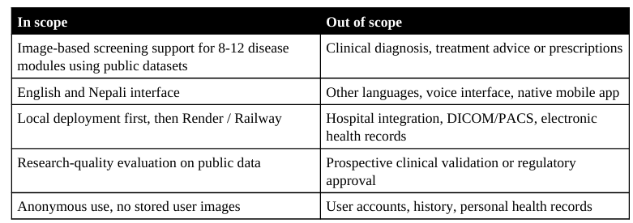
Scopes and Limitations

Slide 7
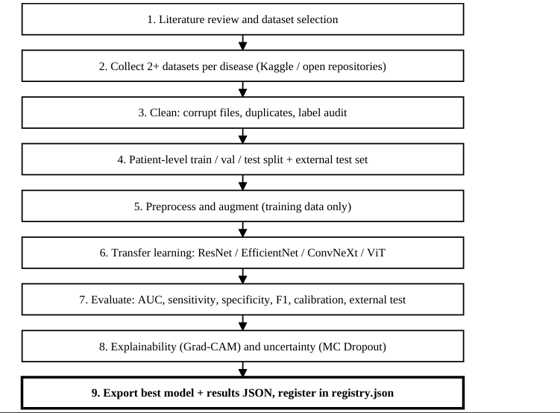
Model Pipeline

Slide 8
System Requirements
Functional Requirements
Platform Home and Navigation
Image Upload and Prediction
Model Transparency
Model Management
General

Slide 9
Non-Functional Requirements
Prediction response time 5s or less
Internal-test AUC of 0.90
English /Nepali platform
Responsive
No storage

Slide 10
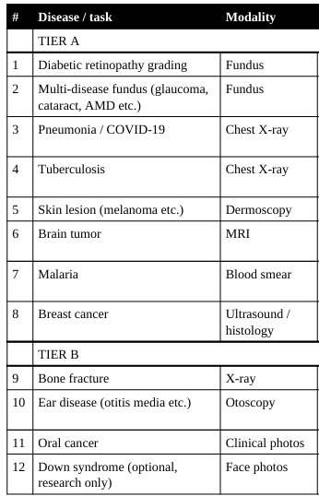
Disease Modules

Slide 11
Model Training
Backbones
Two-phase transfer learning
Augmentation
Handle class imbalance
Early stopping
Training runs on Kaggle notebooks

Slide 12
Evaluation Strategy
Discrimination
Confidence intervals
Calibration
Internal dataset
External dataset
Multiple dataset

Slide 13
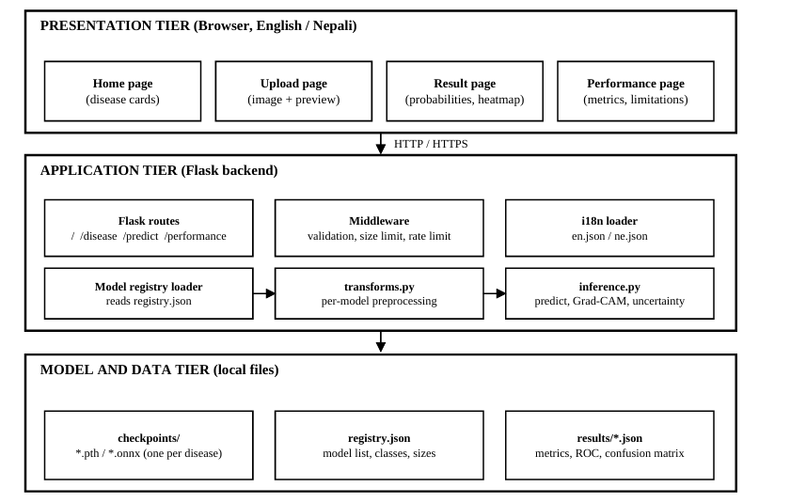
System Architecture

Slide 14
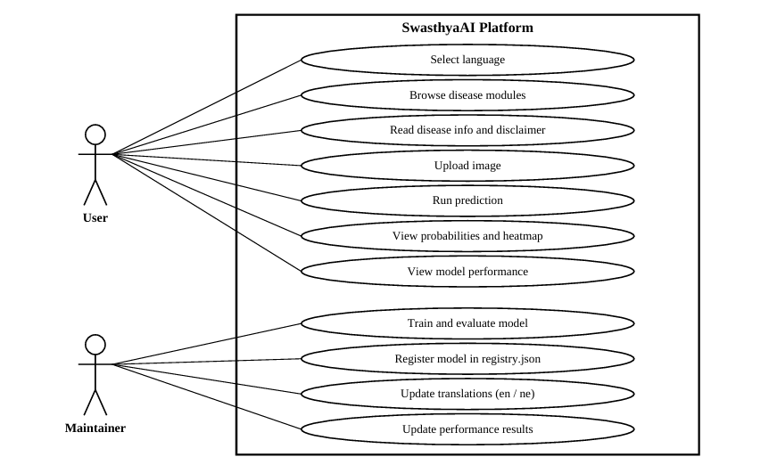
Usecase Diagram

Slide 15
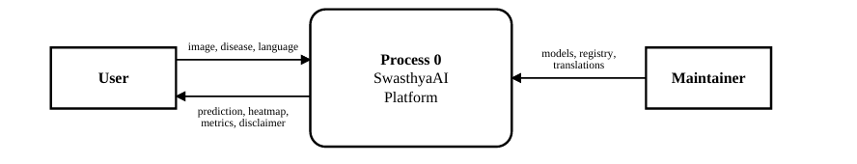
Dataflow Diagram
Fig : Level 0 DFD

Slide 16
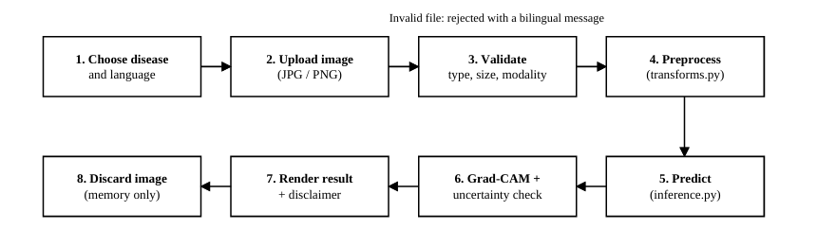
Fig:Level 1 DFD

Slide 17
Ethics, Limits and Risks
Ethical Considerations
Not a diagnosis
Privacy
Data licensing
Sensitive modules
Honest reporting

Slide 18
Risk and Mitigations
Domain shift
Dataset leakage and duplicates
Models learn shortcuts
Over-claiming
small or poor-quality datasets
Hosting Limits

Slide 19
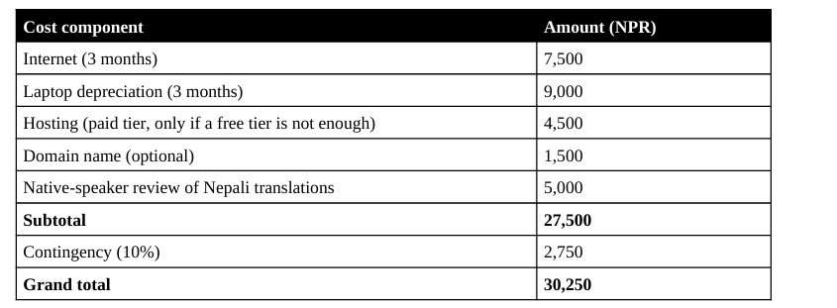
Cost Estimation

Slide 20
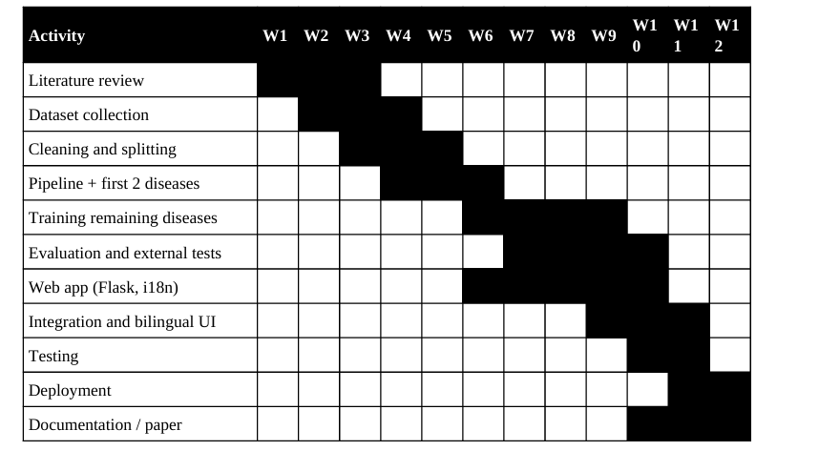
Project Schedule

Slide 21
Proposed Deliverables
Trained models disease modules with their results
Platform running locally and deployed online.
Cleaned-dataset scripts, data cards, split files and training/evaluation code
Internal and external results for every module.
multi-dataset and cross-dataset findings.
Bilingual user guide, presentation slides and a demo video.

Slide 22
Conclusion
SwasthyaAI proposes a practical and honest way to bring medical image AI closer to the public by combining a multi-dataset, externally validated training pipeline and a simple bilingual web interface.It is screening platform not a diagnosis which helps education and research.
All results will be presented as screening support, with their limitations stated openly.

